Slide 1
Good introduction can make a day…. Making Introductions
Mrs. Madhavi A. Moharil
Dept. of English
Rajkumar Kewalramani Kanya Mahavidyalaya,
Nagpur

Slide 2
Introducing Yourself
Signal / Greetings
Introduction
Additional Introduction
Closure

Slide 3
Informal Introductions
Hello. I am Rita. I think we met earlier. Nice to meet you again.
2. Hi. I am Ramesh. I am Shekhar’s friend. Good to see you.
Hello Manisha. My name is Medha. I think we met at Rakhi’s house. Glad to see you again.

Slide 4
Formal Introduction
Good morning everyone. I am Ishita. I am the student of R. K. college. It’s been pleasure speaking to you.
May I introduce myself? My name is Raghav. I work for Reliance. It is nice to meet you.
Good afternoon. My name is Radha Kulkarni. I have been working with TCS since last five years. I am glad to meet you.
Hello, first of all let me introduce myself. I am Suchita Ram. I am from Amravati. Recently I have joined the company. Good to see you all.

Slide 5
Introducing Yourself in Interviews

Slide 6
Introducing Yourself in Interviews
Greet the panel.
Tell your name, your native place.
Tell about your qualification and experience.
Feel comfortable to tell your hobbies or the things you love/interest/grades.
Speak about any unique thing or something you wish them to know about you tell it with confidence.

Slide 7
While introducing yourself in an interview……
Prepare to introduce yourself beforehand.
Memorize the script.
Practice in front of mirror or camera.
Speak moderately but clearly.
Introduce yourself energetically.
Maintain the eye-contact.
Peaceful facial expressions.

Slide 8
Deepak Choudhary said: (Fri, Oct 2, 2015 12:26:29 PM) Good morning Sir/Mam. Thank you for giving me an opportunity to introduce me in front of you. I am Deepak Choudhary, from Bharatpur, Rajasthan.
I have done engineering in Civil department at SVNIT Surat, Gujarat. I am punctual, sincere and devoted to work. I feel these are assets in my personlity. I easily believe on anyone and develops quick emotional attachment. Sometimes I feel it as my weakness. My short term goal to get a job and my long term goal to reach on a respectable position at a company. Speaking about my family, there are six members including me. My father is a farmer and my mother is a housewife. My hobbies are watching movies, reading books, playing kabbadi, tennis and collecting coins. As I am fresher and I don't have work experience but I assure to you that I will work with full enthusiasm and punctuality. It will be my honor to work with your company. Thank you so much.

Slide 9
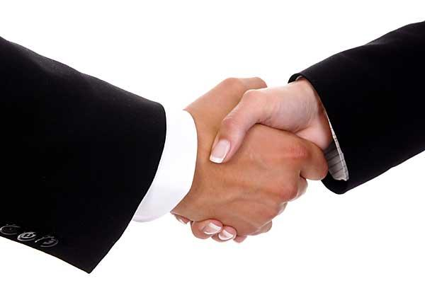
Some tips to follow while introducing yourself in the interview…
Neat and clean dressing style.
Keep a smile on the face.
Shake hands with warmth and confidence.
Keep faith in yourself.
Be calm.

Slide 10
Introduce yourself with confidence and
optimism because a good introduction
can win the day and build the future….
Good Luck.

Slide 11
Thank You

